Slide 1

Streamlit
Deployment

Slide 2
Streamlit App
A Streamlit app is essentially a Python script that runs like a web application.
We write Python code only.
It automatically creates a user interface (inputs, buttons, sliders, charts, tables, etc.).
It’s interactive: whenever a user changes an input, the app updates instantly.

Slide 3


Slide 4
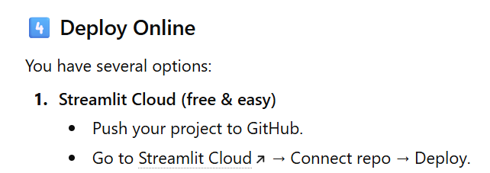


Slide 5
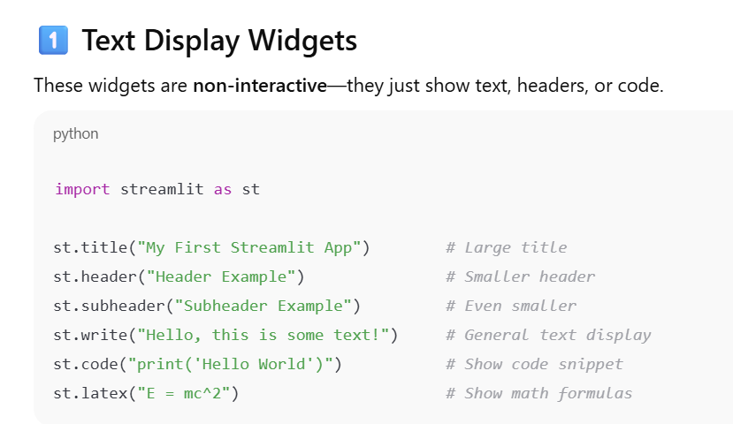

Slide 6
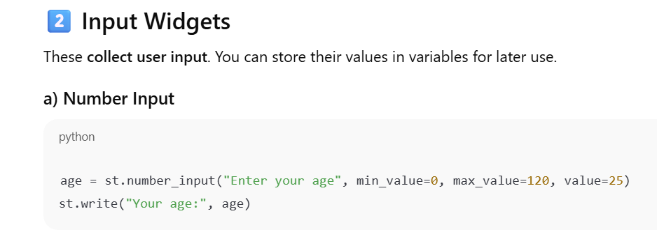

Slide 7
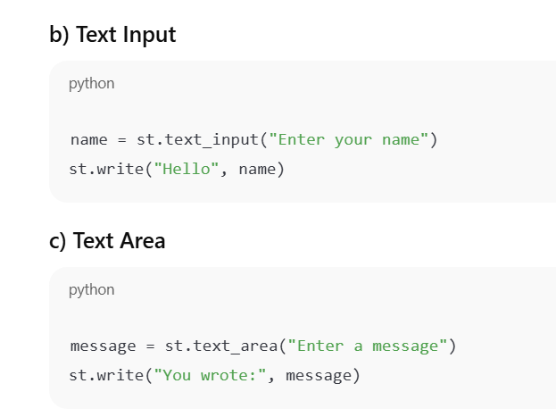

Slide 8
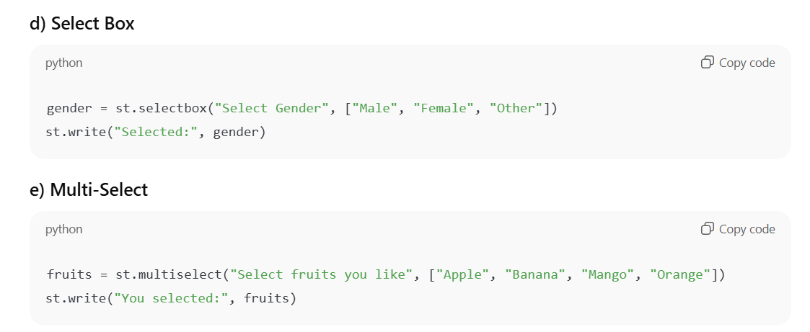

Slide 9
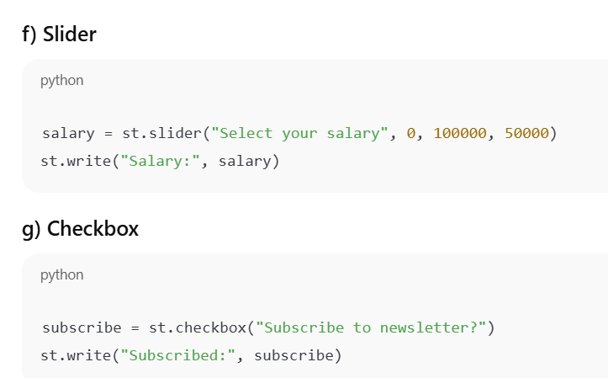

Slide 10
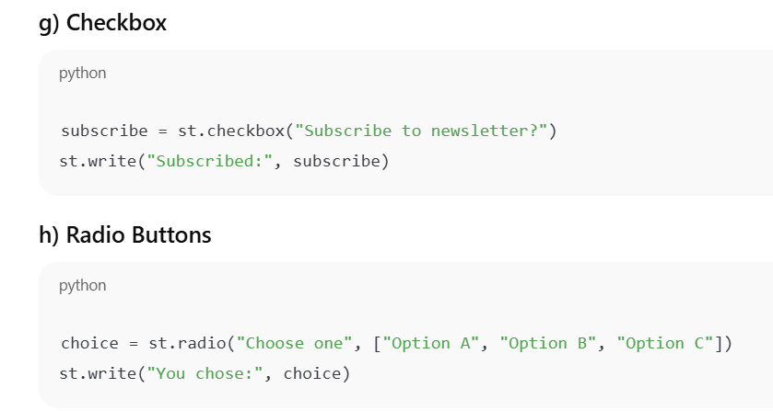

Slide 11
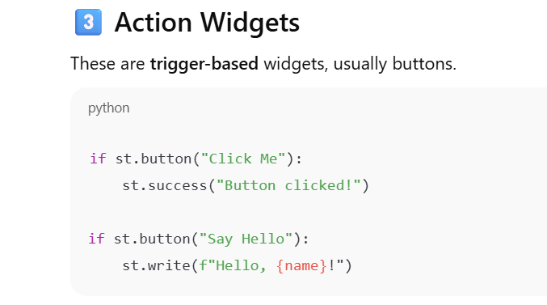

Slide 12
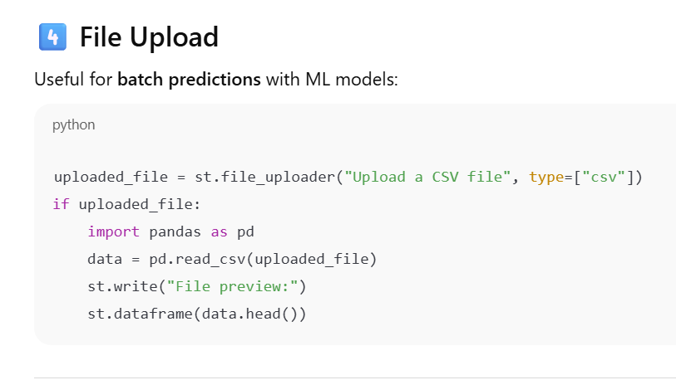

Slide 13
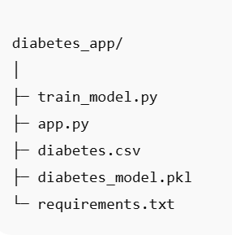

Slide 14
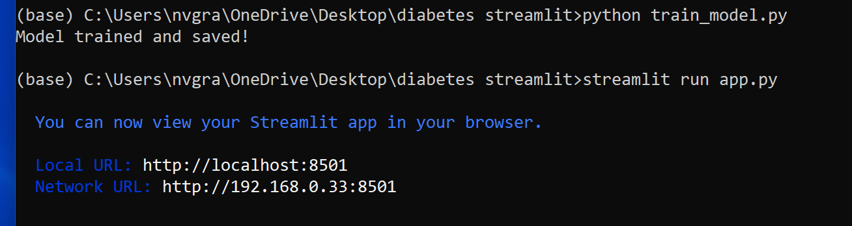

Slide 15
